Slide 1
Review of Python

Slide 2

What is Python?
Python is a popular programming language created by Guido van Rossum in 1991
Source: https://education.ti.com/-/media/ti/t3-europe/images/blog/blog-python-blog-guido.jpg?la=en&rev=95242eee-3bf7-4e81-9129-c182340f6f2e&hash=769F0610FF480C27CC4D3344A24C4D4AEB2BAE73

Slide 3
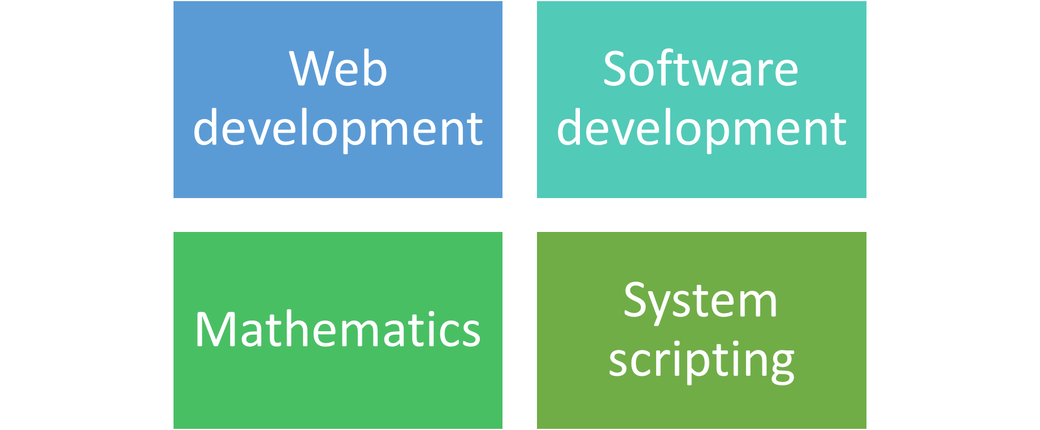
Uses of Python

Slide 4
Why Python?
Python works on different platforms (Windows, Mac, Linux, Raspberry Pi)
Python has a simple syntax similar to the English language.
Python has syntax that allows developers to write programs with fewer lines than some other programming languages
Python runs on an interpreter system
Python can be treated in a procedural way, an object-oriented way or a functional way

Slide 5
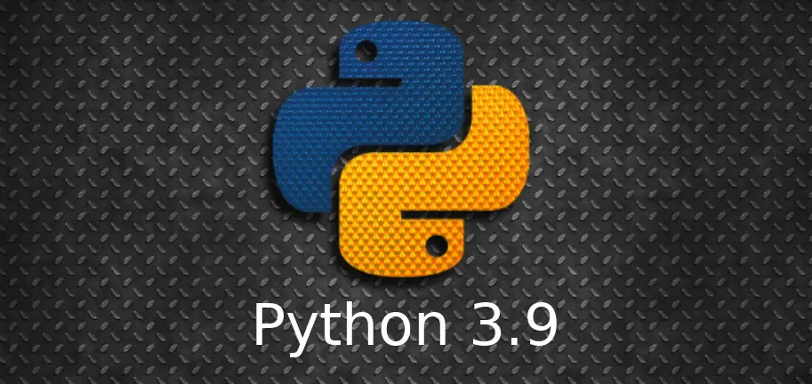
Latest version of Python on October 5, 2020
Source: https://www.debugpoint.com/blog/wp-content/uploads/2020/10/pythin39.jpg

Slide 6
Python Indentation
Indentation refers to the spaces at the beginning of a code line
Example:
if 5 > 2:
print("Five is greater than two!")

Slide 7
Python Comments
Comments can be used to explain Python code and make the code more readable
Comments start with #
Example:
#This is a comment
print(“Hello, world”)

Slide 8
Variable Naming Conventions
A variable can have a short name (like x and y) or a more descriptive name (age, carname, total_volume). Rules for Python variables:
  A variable name must start with a letter or the underscore character
  A variable name cannot start with a number
  A variable name can only contain alpha-numeric characters and underscores (A-z, 0-9, and _ )
  Variable names are case-sensitive (age, Age and AGE are three different variables)

Slide 9
Correct or Not?
myvar = "John“
2myvar = "John“
_my_var = "John“
myVar = "John“
my var = "John"

Slide 10
Python Variable
Variables are containers for storing data values
Example:
x = 1
a, b=0,-1
a, b, c=0,-1, 2
Others:
b = “Sally” #This is a type of string

Slide 11
Casting
  b="sally" #This is a type of string
  b=int(4)
  print(b)
  b=float(4)
  print(b)

Slide 12
Type() function
Example
x = 5
y = "John"
print(type(x))
print(type(y))

Slide 13
“Double quotes” or ‘Single’ quotes
String variables can be declared either by using single or double quotes:
Example:
y = "John"
y = ’John’

Slide 14
Case sensitive
Example:
a = 4
A = "Sally"
#A will not overwrite a

Slide 15
Multiple Variables
Example:
x, y, z = “one", “two", “three"
print(x)
print(y)
print(z)

Slide 16
One Value to Multiple Variables
Example:
x = y = z = "four"
print(x)
print(y)
print(z)

Slide 17
Output Variables
The python print is used to output variables and + is used to combine both text and variable
Example:
x = “enjoying"
print("Python programming is " + x)

Slide 18
Other way:
x = "Python is "
y = “enjoying"
z = x + y
print(z)

Slide 19
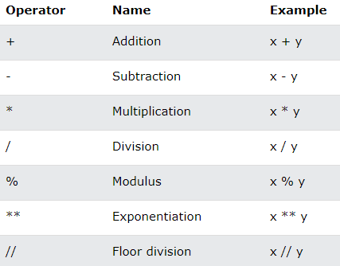
Arithmetic Operations

Slide 20
Example:
x = 5
y = 3
print (x + y)
x=5
y=3
sum=x+y
sum

Slide 21
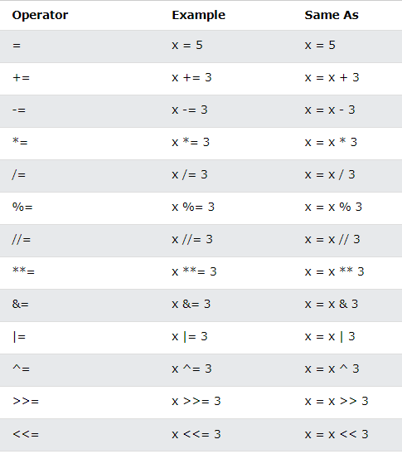
Assignment Operators

Slide 22
Example:
a,b,c=0,-1,6
c%=3
c

Slide 23
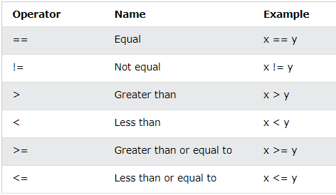
Comparison Operators

Slide 24
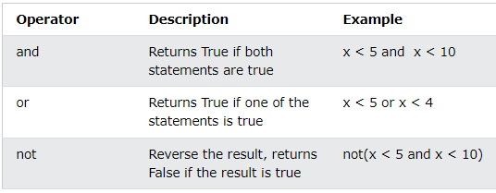
Logical Operators

Slide 25
Example:
a,b,c=0,-1,6
a>b and c>b
True

Slide 26
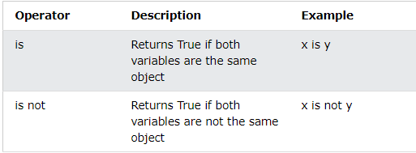
Identity Operators

Slide 27
Example:
a,b,c=0,-1,5
a is c
False

Slide 28
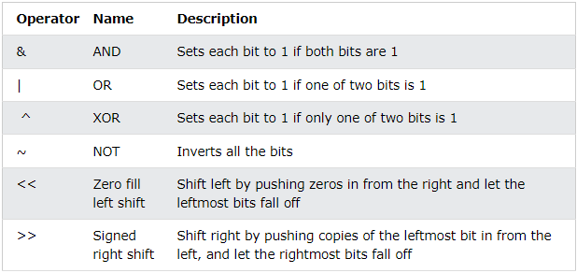
Bitwise Operators

Slide 29
References
Source: https://www.w3schools.com/PYTHON/python_intro.asp
https://www.webopedia.com/TERM/O/object_oriented_programming_OOP.html
Dooley, John . “Object Oriented Analysis and Design Process” .Software Development, Design and Coding pp 95-101

